Slide 1



TOPIC: Digital Payment Awareness
COURSE: CCC Concepts
DAY:42
Presented By: Shruti Dubey

Slide 2
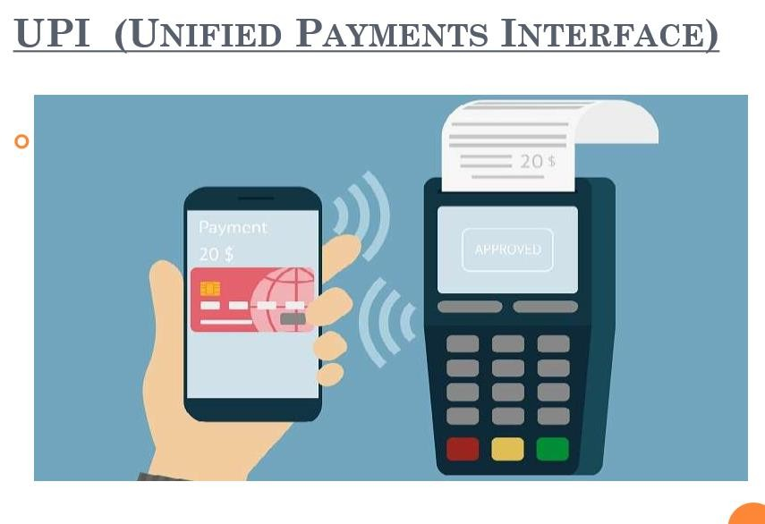

Slide 3
UPI (Unified Payments Interface)
What do we need?
A bank account
A Smartphone with UPI application (app)

Slide 4
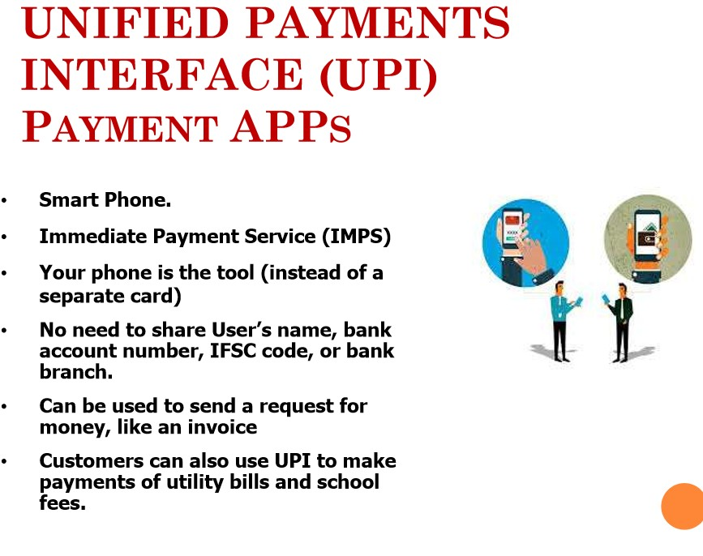

Slide 5
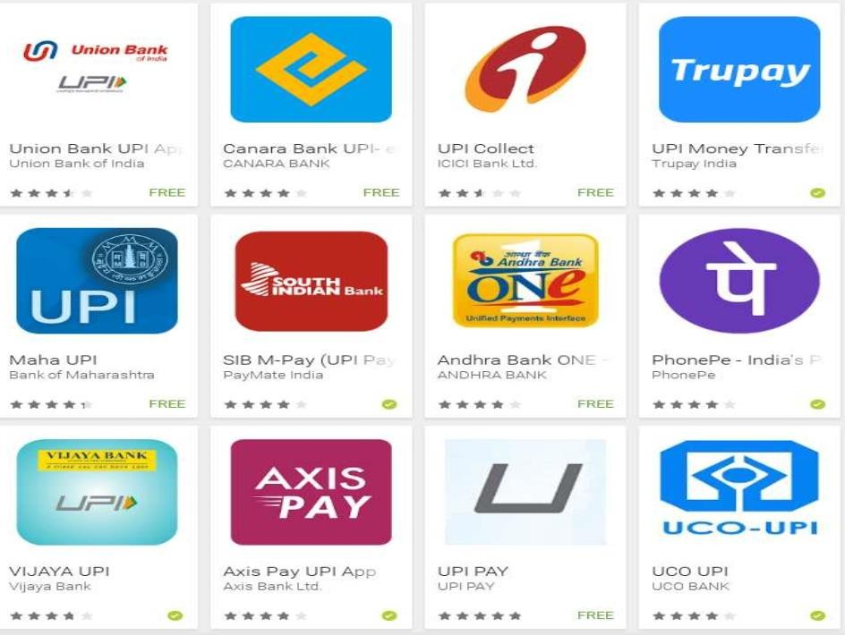

Slide 6
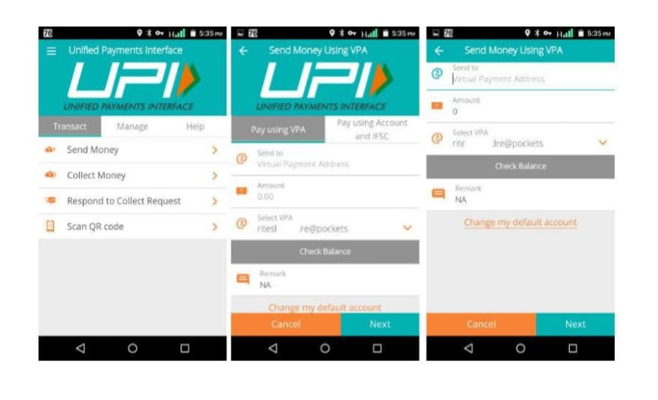

Slide 7
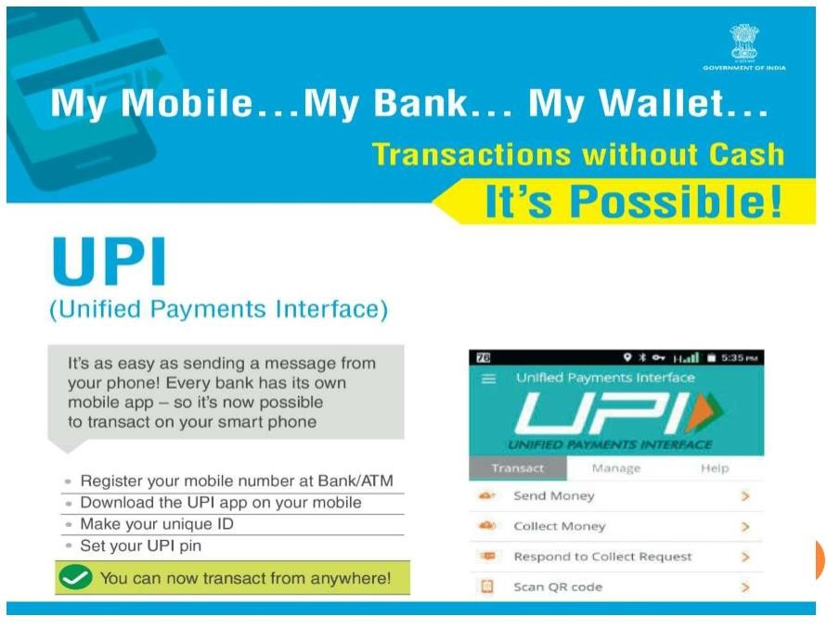

Slide 8
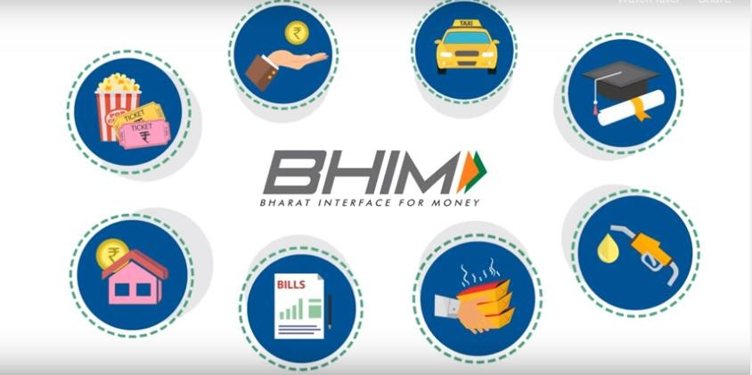
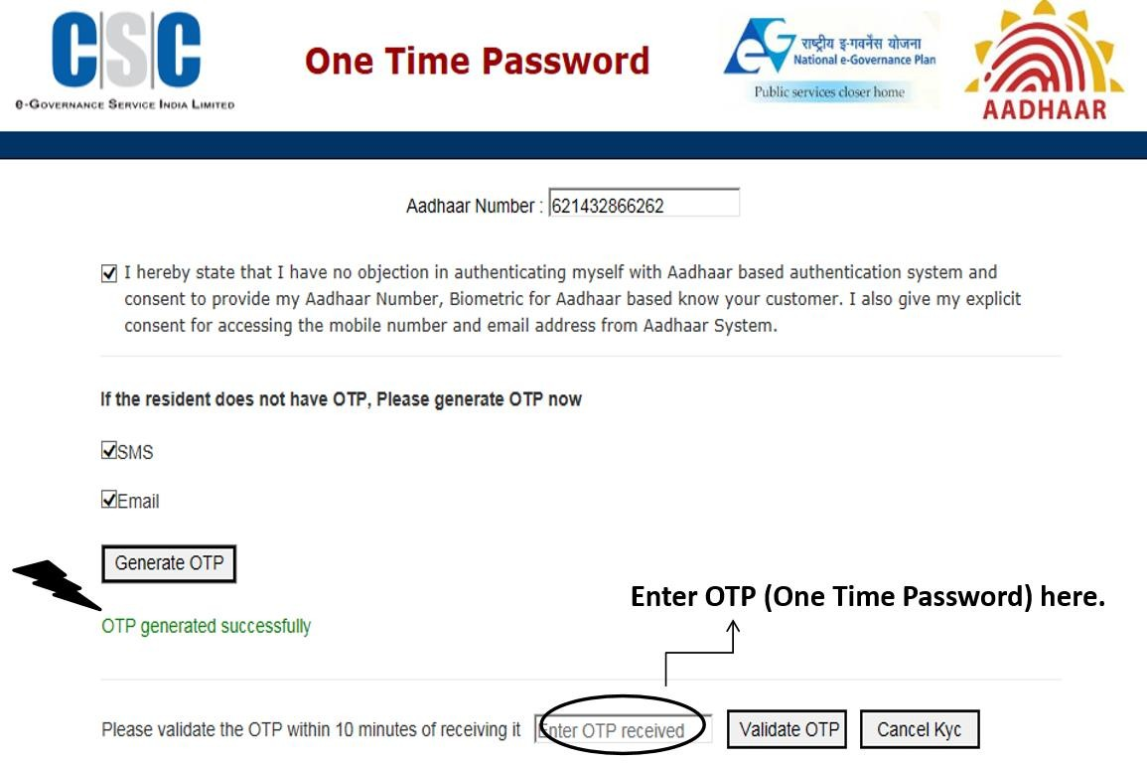
Digilocker
https://digilocker.gov.in/

Slide 9
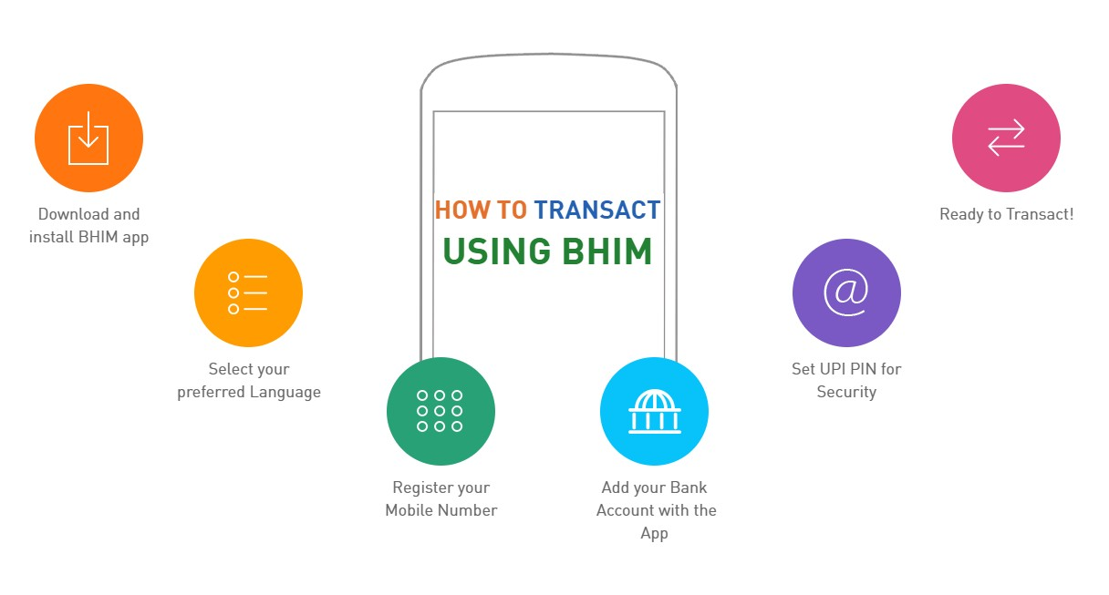
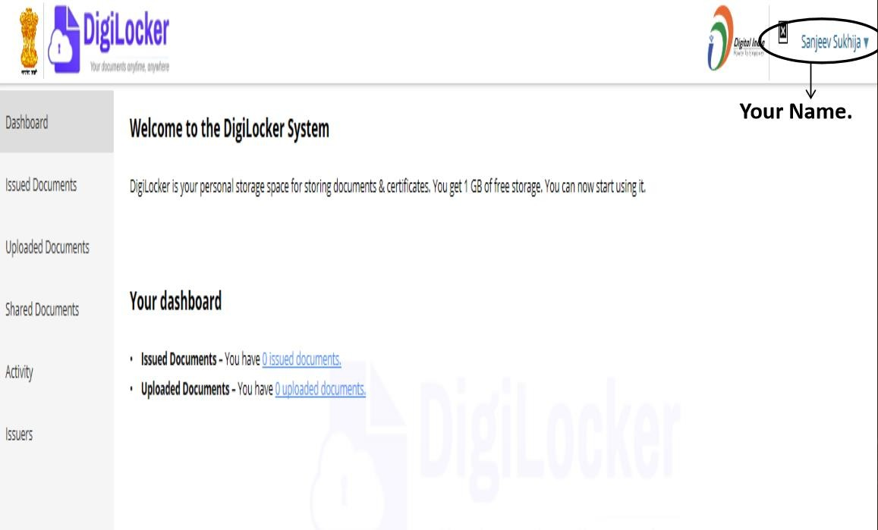
Digilocker

Slide 10
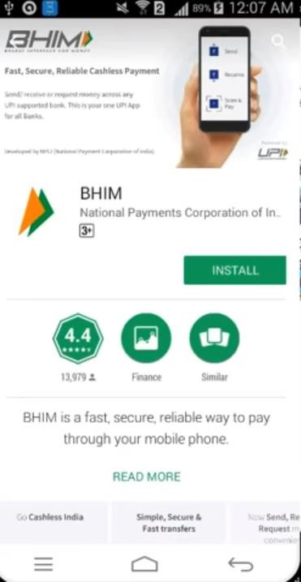
Installing UPI App (BHIM)

Slide 11
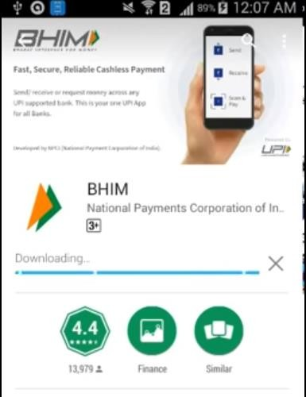
Installing UPI App (BHIM)

Slide 12
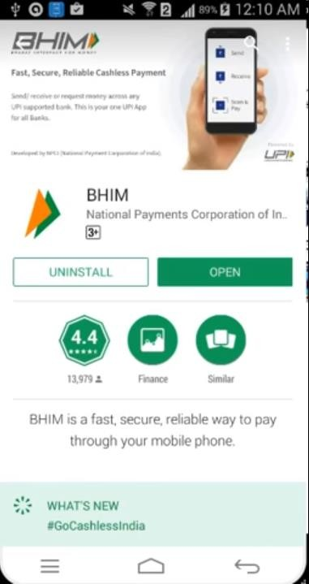
Installing UPI App (BHIM)

Slide 13
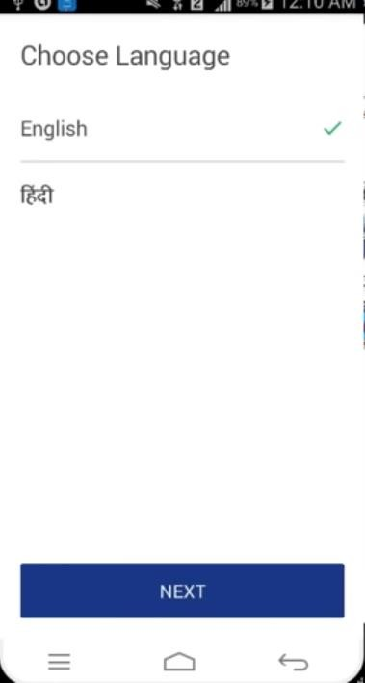
Activation Contd…

Slide 14
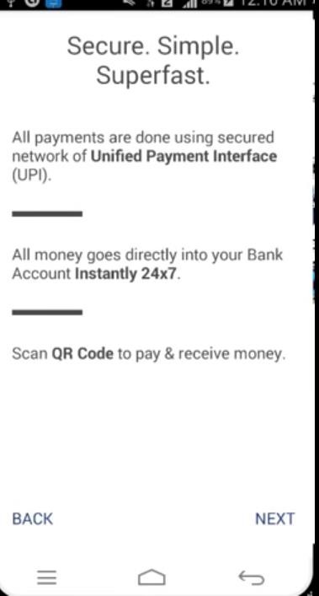
Activation Contd…

Slide 15
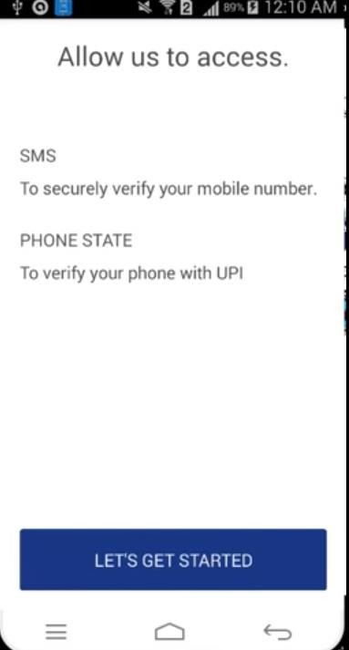
Activation Contd…

Slide 16
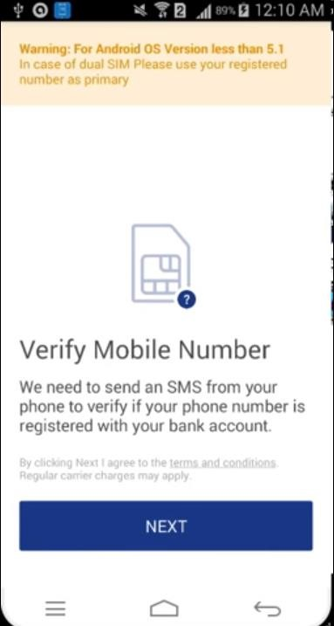
Activation Contd…

Slide 17
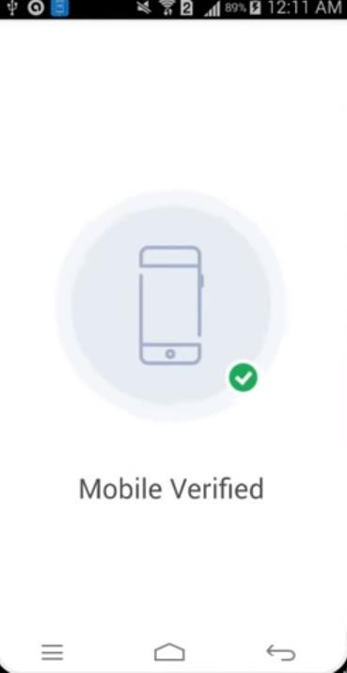
Activation Contd…

Slide 18
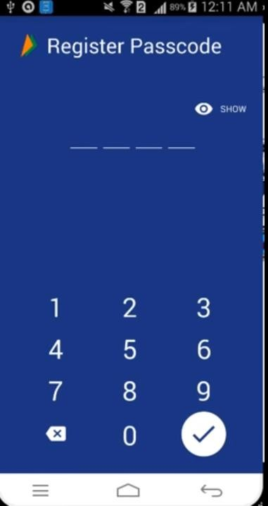
Activation Contd…

Slide 19
Activation Contd…

Slide 20
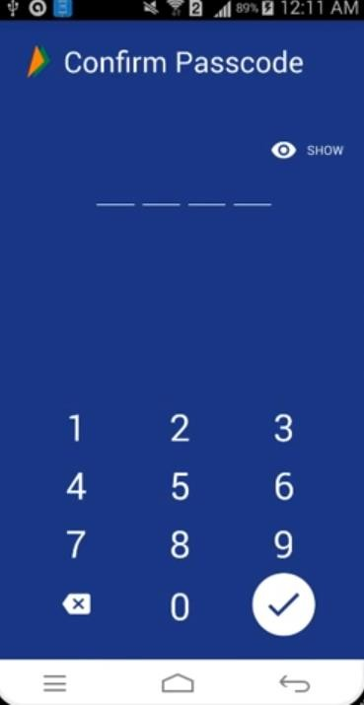
Activation Contd…

Slide 21
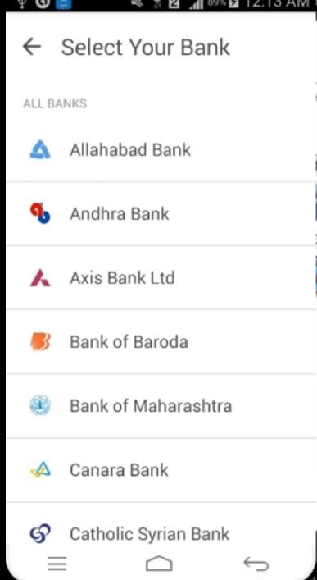
Activation Contd…

Slide 22
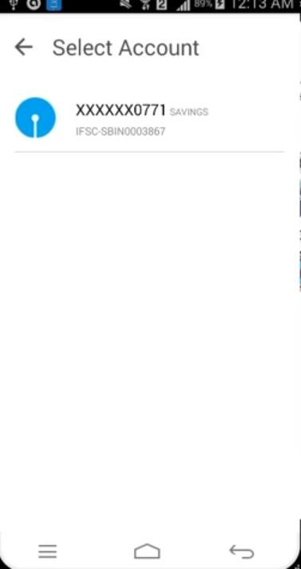
Activation Contd…

Slide 23
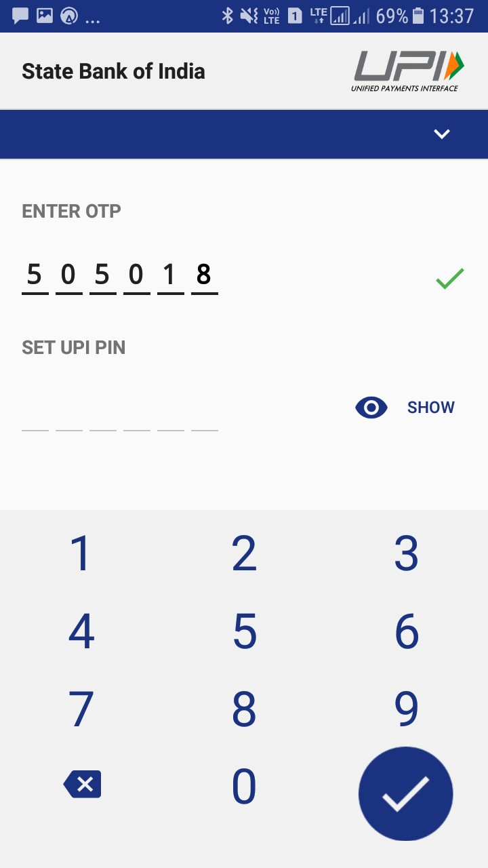
Activation Contd…

Slide 24
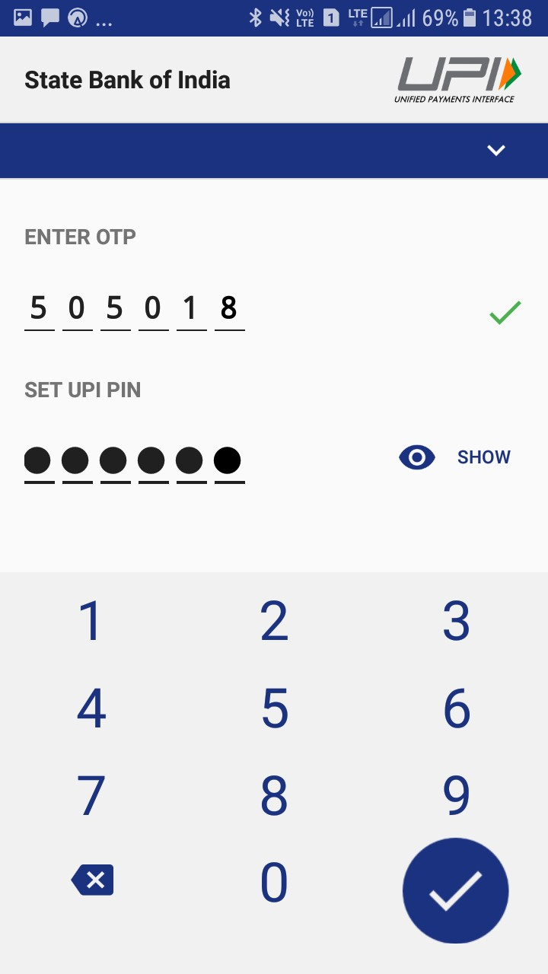
Activation Contd…

Slide 25
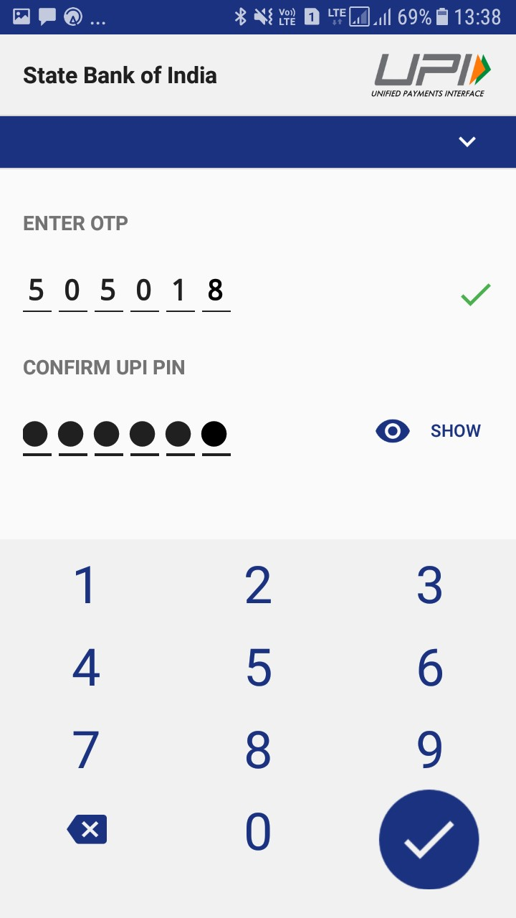
Activation Contd…

Slide 26
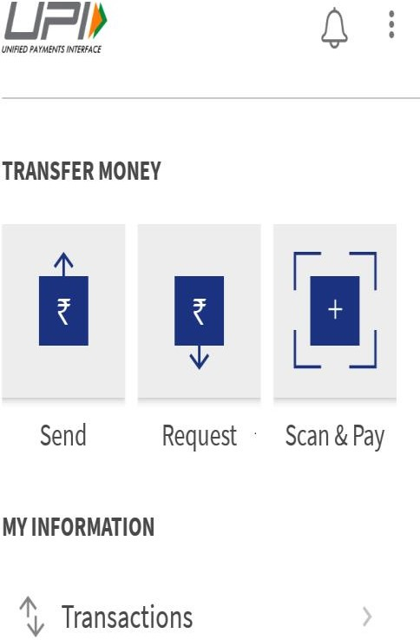
Starting Transaction

Slide 27
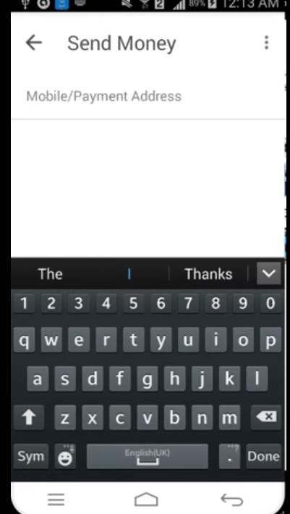
Starting Transaction

Slide 28
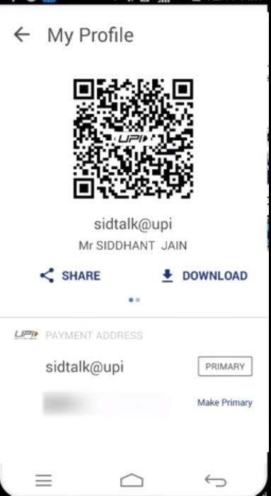
Starting Transaction

Slide 29
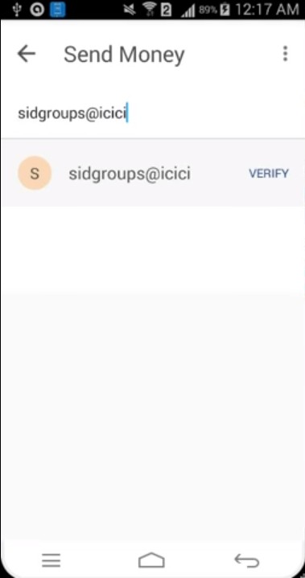
Starting Transaction

Slide 30
Starting Transaction

Slide 31
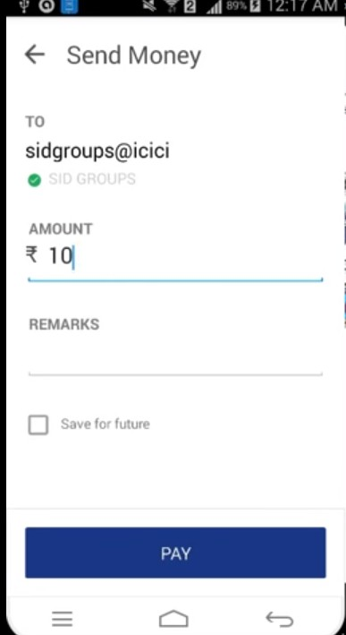
Transaction Successful

Slide 32
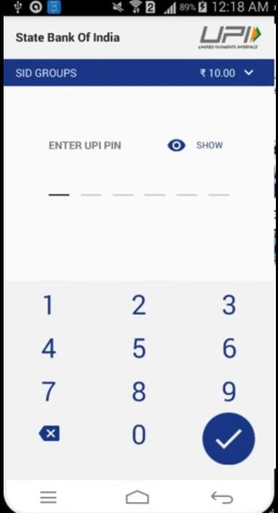
Transaction Successful

Slide 33
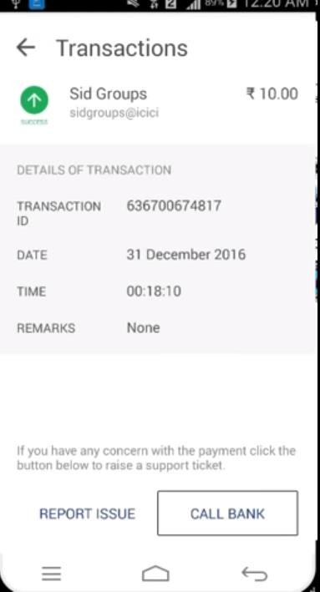
Transaction Successful

Slide 34
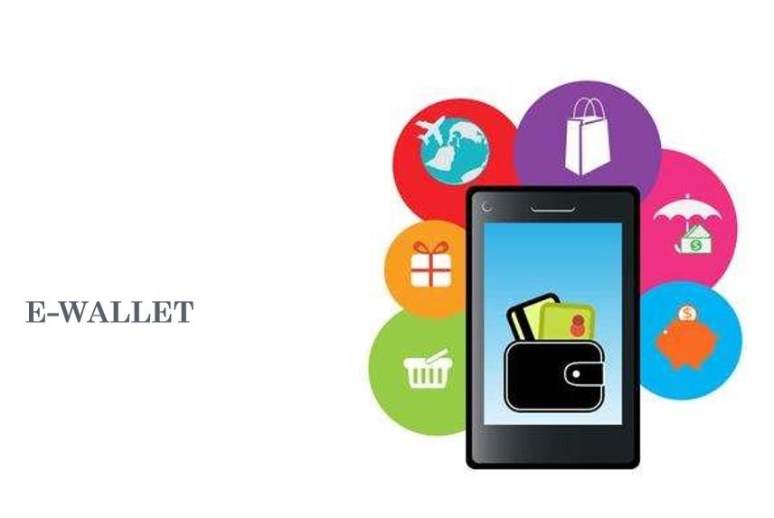

Slide 35
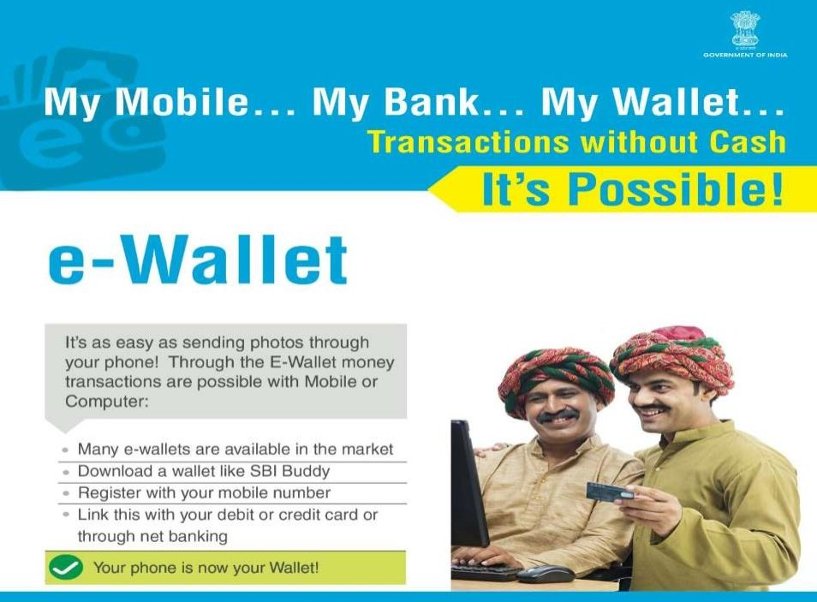

Slide 36
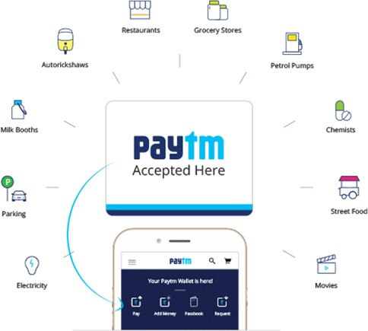
What is Paytm

Slide 37

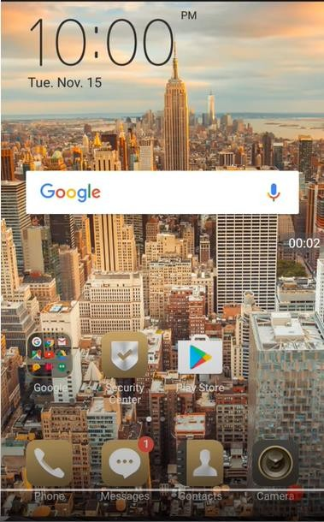
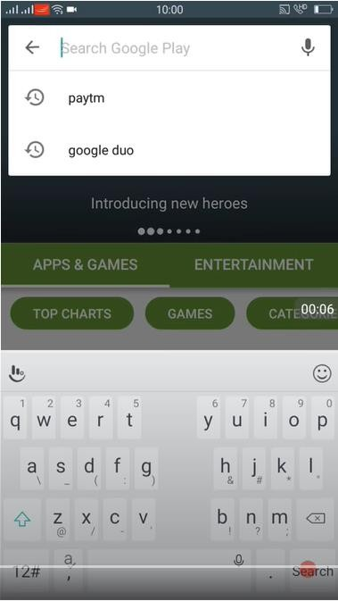

Installation of Paytm

Slide 38
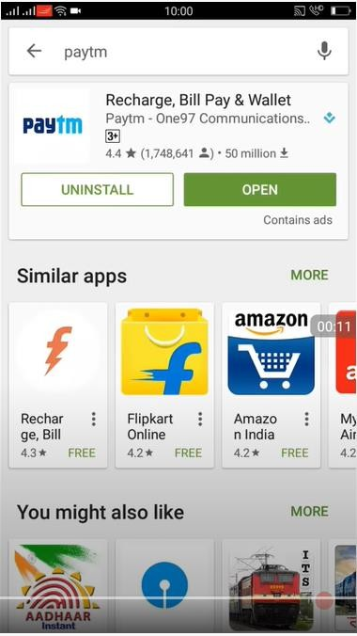

Installation of Paytm

Slide 39
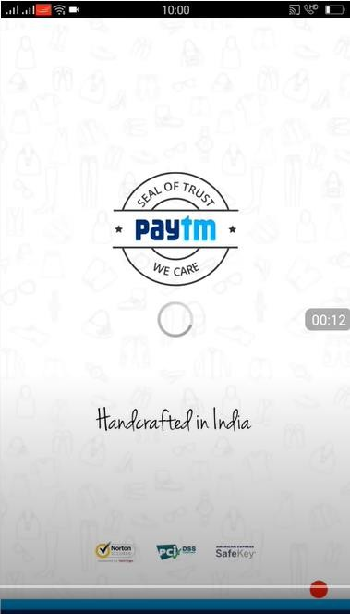

Installation of Paytm

Slide 40
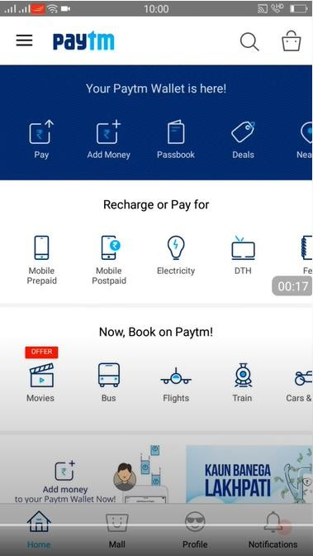

Installation of Paytm

Slide 41
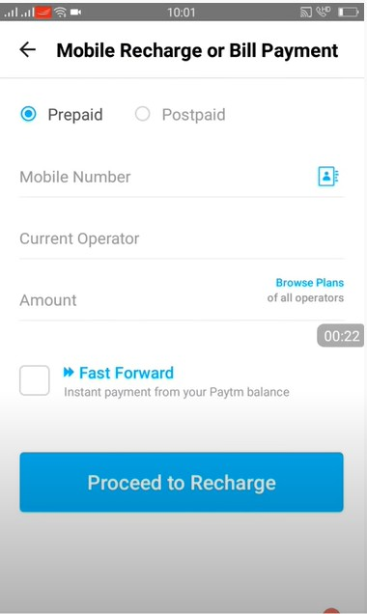

Installation of Paytm

Slide 42

Installation of Paytm

Slide 43
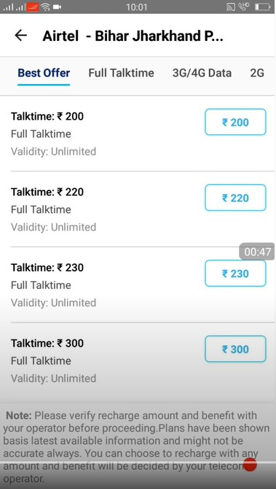

Installation of Paytm

Slide 44
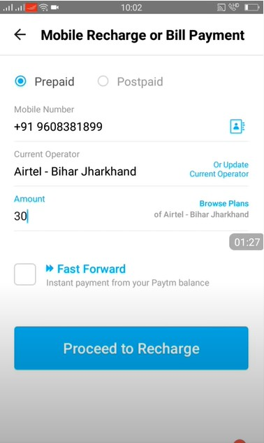


Installation of Paytm

Slide 45
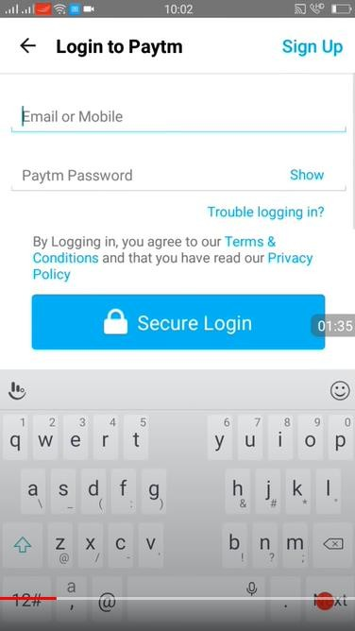


Installation of Paytm

Slide 46

Installation of Paytm

Slide 47
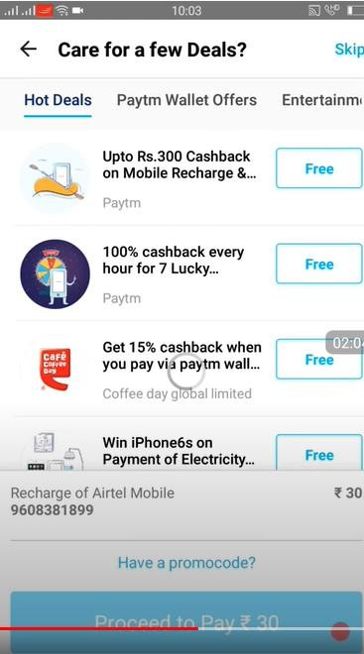

Installation of Paytm

Slide 48
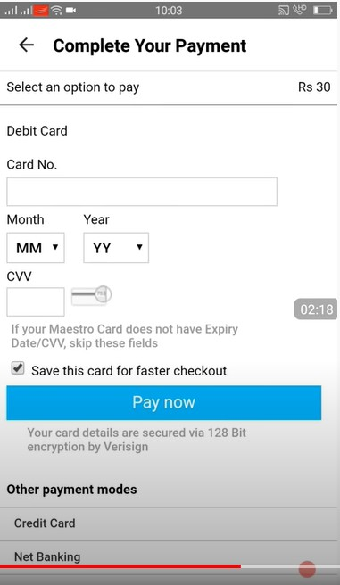




Installation of Paytm

Slide 49
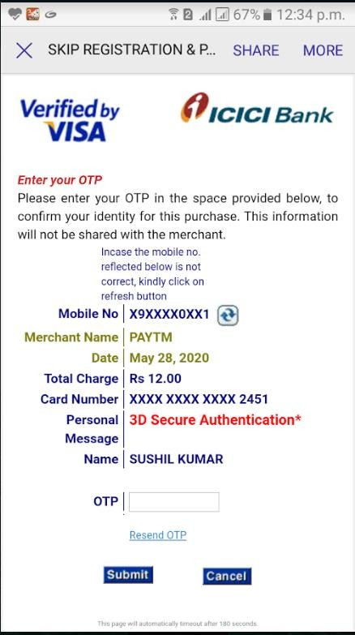



Installation of Paytm

Slide 50

Installation of Paytm

Slide 51
Thank you!
www.nielit.gov.in/haridwar

